Slide 1
City Gate 2.0 Phases 2 and 3 TIF review
Colorado Springs Urban Renewal Authority

Slide 2
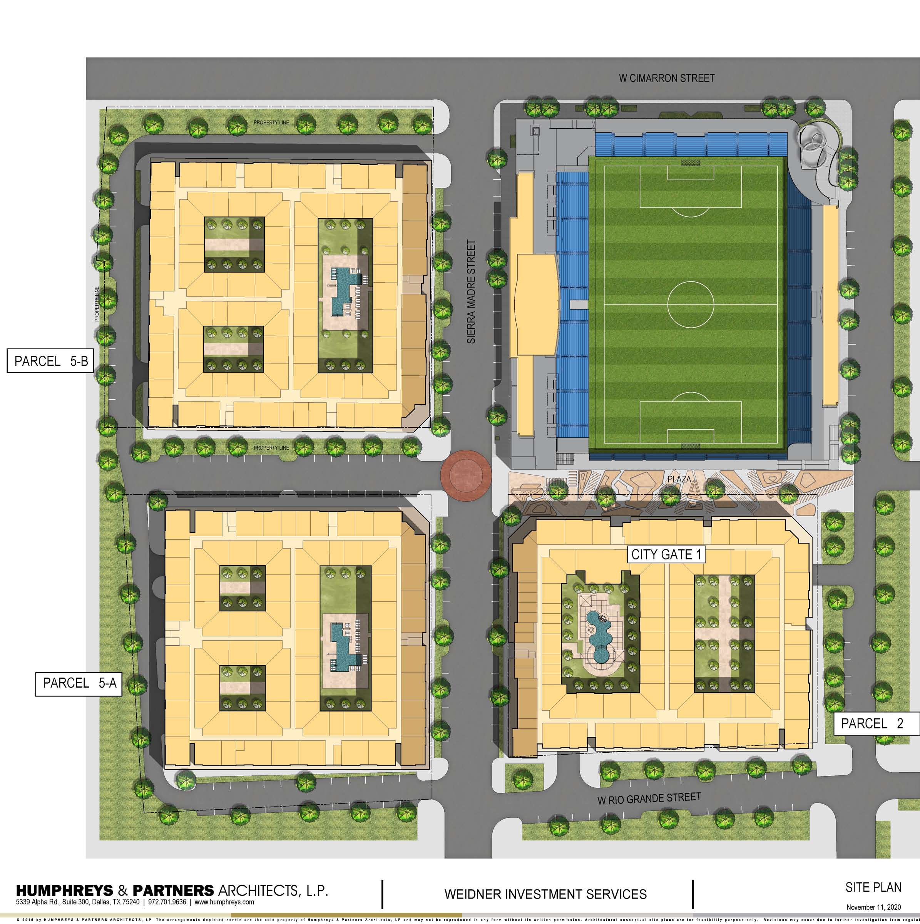
City Gate 2.0
Mixed use development
Residential
Retail
Pedestrian plazas
Vibrant, walkable area adjacent to soccer stadium
Parking
Structured & off-street
Additional public amenities
Public art, sidewalks, trees, streetscape

Slide 3
Program Overview
Residential
1,182 units
Market rate rental project
Rents ranging from $1,290/unit to $2,955/unit
Average rental rates of $2,192/unit or $2.80/sf
Average unit size 1,327 sf

Slide 4
Program overview
retail
37,346 sf of ground floor retail
$1.67-$2.00 rent per sf

Slide 5
Program overview
Parking
2,058 parking spaces
1,100 private
869 public
89 off-street
Private monthly rates $125-$133 per space
Public daily rates $5-$7 per space
Public event rates $15-$17 per space
Estimated $226,992 parking revenue per month at buildout

Slide 6
Public improvements
City gate 2.0
$55.6 million in public improvements
Public parking (869 spaces):$32.9M
Pedestrian plazas: $3M
Street and safety improvements: $3.2M
Utilities: $3M
Demolition: $3.4M
Façade Enhancements/Art: $10M

Slide 7
City Gate 2.0 Phase 2

Slide 8
Construction Costs
Phase 2
Land: $5.8M
$16,200/unit
4% of total cost
Hard Costs: $109.2M
Hard Costs w/o public imp.: $99.2M ($274,800/unit or $158/sf)
Hard Costs for public imp: $10M ($27,700/unit or $16/sf)
Soft Costs: $20.5M
$56,700/unit or $33/sf
15% of total cost
Total Cost: $135.5M

Slide 9
Static performance
Phase 2
Effective Gross Income: $9.8M/yr.
Average rental rates of $2,114/unit or $2.70/sf
5.0% vacancy factor
Operating Expenditures: $3.0M/yr.
31% of gross income
Net Operating Income: $6.8M

Slide 10
Static performance: with and without TIF
Phase 2
Target Hurdle Rate: 5.75% YOC (NOI/COST)
In order to achieve that hurdle rate, net project costs need to be reduced to $16.8M
Current costs are estimated at $135.5M
The present value of future TIF revenue is estimated at $9.9M
With this amount, the project achieves a YOC of 5.43%

Slide 11
TIF Revenue: Property Tax Increment
Phase 2
Total: $17.3M (nominal)

Slide 12
TIF Revenue: Sales Tax Increment
Phase 2
Total: $3.4M (nominal)

Slide 13
City Gate 2.0 Phase 3

Slide 14
Construction Costs
Phase 3
Land: $8.4M
$20,300/unit
5% of total cost
Hard Costs: $147.7M
Hard Costs w/o public imp.: $128.5M ($311,000/unit or $182/sf)
Hard Costs for public imp: $19.3M ($46,700/unit or $27/sf)
Soft Costs: $24.2M
$58,500/unit or $34/sf
13% of total cost
Total Cost: $180.3M

Slide 15
Static performance
Phase 3
Effective Gross Income: $12.5M/yr.
Average rental rates of $2,308/unit or $2.95/sf
5.0% vacancy factor
Operating Expenditures: $3.7M/yr.
30% of gross income
Net Operating Income: $8.8M

Slide 16
Static performance: with and without TIF
Phase 3
Target Hurdle Rate: 5.75% YOC (NOI/COST)
In order to achieve that hurdle rate, net project costs need to be reduced to $26.9M
Current costs are estimated at $180.3M
The present value of future TIF revenue is estimated at $8.9M
With this amount, the project achieves a YOC of 5.15%

Slide 17
TIF Revenue: Property Tax Increment
Phase 3
Total: $17.1M (nominal)

Slide 18
TIF Revenue: Sales Tax Increment
Phase 3
Total: $3.0M (nominal)

Slide 19
TiF estimate
Phases 1-3
Total estimated TIF for all phases is $30.1M
Eligible improvements are estimated at $55.6M
Project gap of $57.0M
Based on static performance
The TIF will cover less than half of the total eligible improvements
Longer construction period - project is estimated to reach buildout in 2030

Slide 20
Conclusions
recommendations
“But For” Project Gap
Given the inclusion of the cost of public benefits, there is a gap, which fulfills the “But For” case for each phase
Static proforma for Phase 1-3 identify a gap closure target of approximately $56.9M
Projected TIF revenues will be approximately $30.1M
EPS recommends CSURA approve a TIF allocation of property and sales tax for the 25-year increment based on this analysis for Phases 1-3

