Slide 1
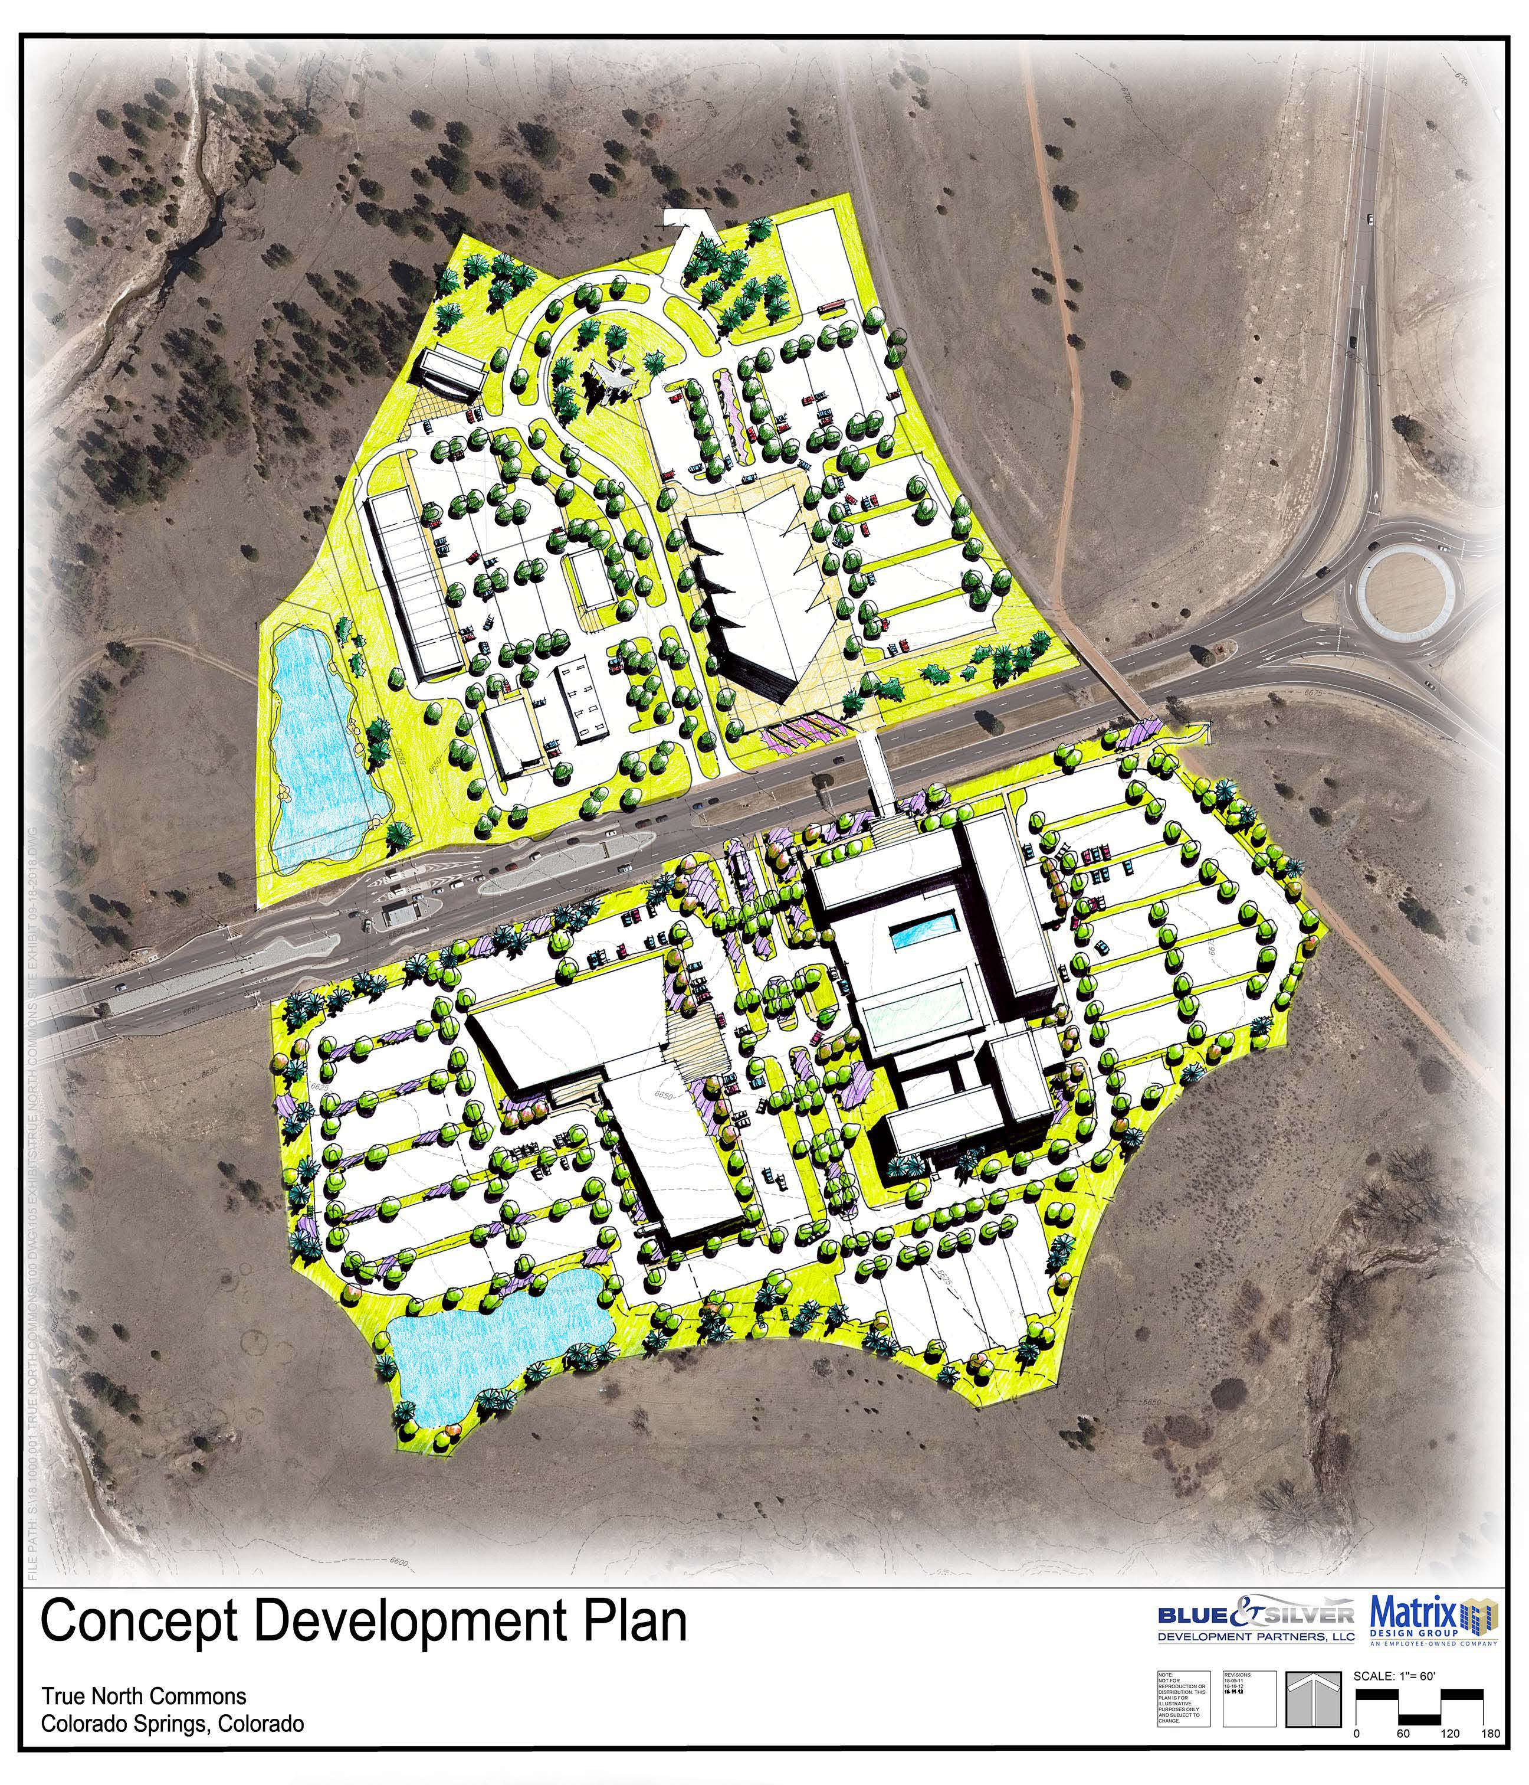

City of Colorado Springs, CO
True North Commons Urban Renewal Plan
12 December 2018
Prepared for:
Colorado Springs Urban Renewal Authority
Presented by:
10959 Ashurst Way
Littleton, CO 80130
303.458.5800 phone
www.rickercunningham.com

Slide 2
Procedures for Creating a Plan
Prepare Documents (“Three Legged-Stool”)
Determine survey area boundaries
Notify property owners (and business interests) within boundaries
Verify presence and location of “blighting” conditions
Document findings in a conditions survey report
-----------
Present survey findings to urban renewal entity and / or governing body for acceptance *
Define boundaries for urban renewal plan area (may be the same as conditions survey)
Complete market assessment in order to verify feasibility and potential impact of projects
Clarify future role of urban renewal area within larger community (comprehensive plan)
Synthesize above items in an urban renewal plan report
-----------
Quantify potential impact of new investment and reinvestment in properties within area
Document analyses in a county impact report (and other impacted taxing bodies)
* Presentation to Council may occur in conjunction with presentation of final urban renewal plan.
1
1

Slide 3
Procedures for Creating a Plan (cont’d)
Present Findings and Consider Adoption
Present urban renewal plan to planning & zoning commission regarding consistency with comp plan
Present urban renewal plan to urban renewal entity for referral to council and adoption
Implement the Plan and Advance Urban Renewal Projects
Work with property and business owners to implement desired private sector investment
Advance plan objectives
2
1

Slide 4
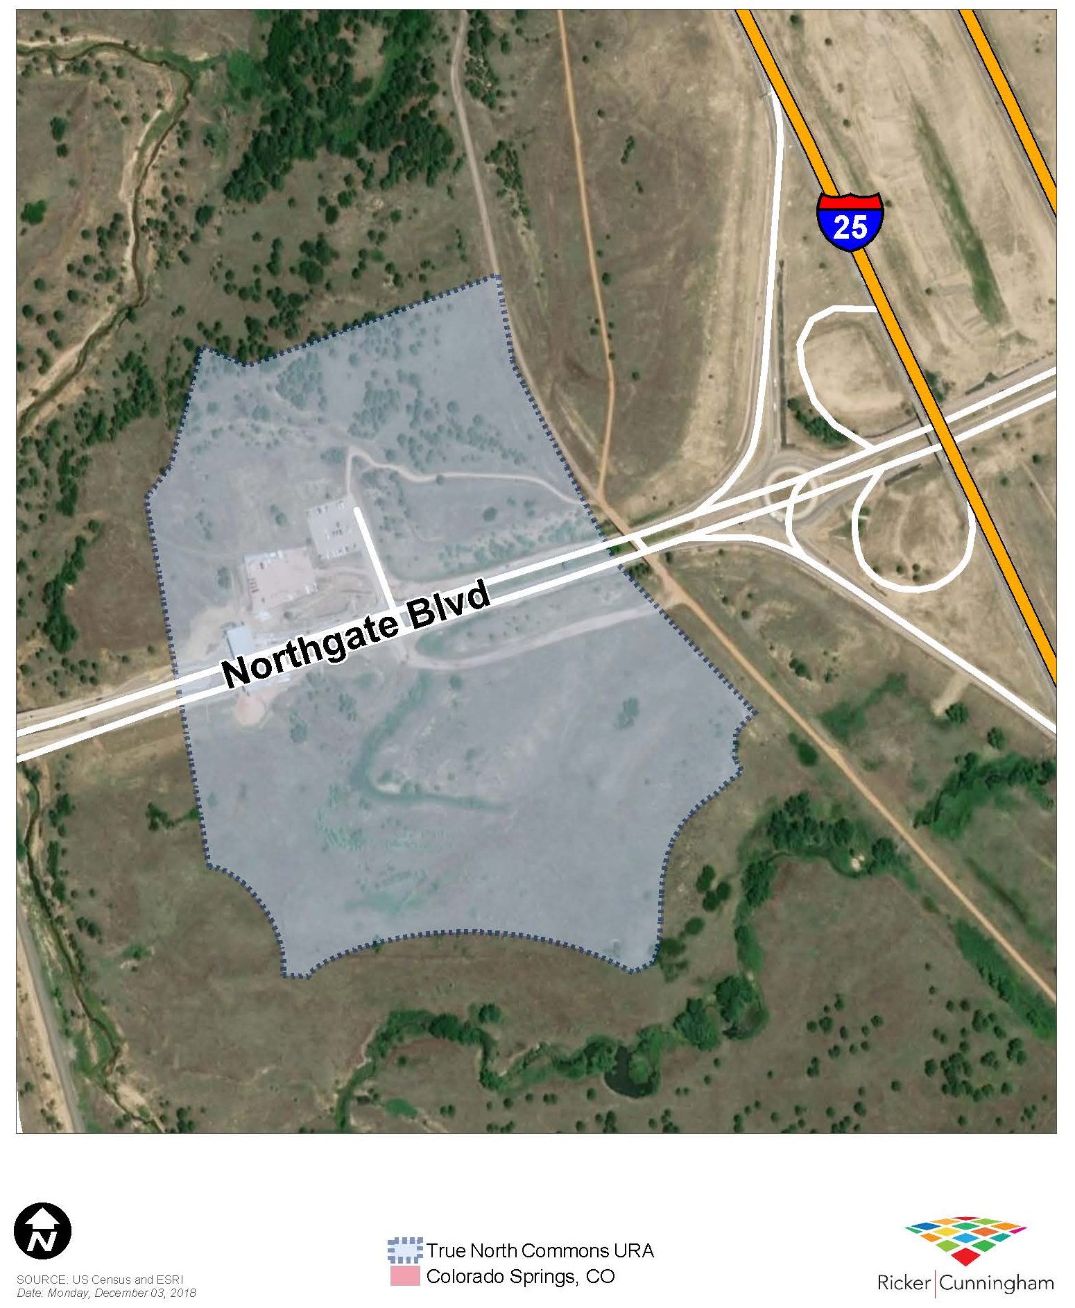
Plan Area Statistics and Boundaries
Boundary Description:
The Urban Renewal Area is approximately 39 acres and includes that segment of Northgate Boulevard that bisects the Area from east to west (herein referred to as the “Survey Area”).
The Survey Area is located in north Colorado Springs, within the United States Air Force Academy (USAFA) federally-owned property. Its boundaries may generally be described as including land located north and south of Northgate Boulevard, near the northwest and southwest quadrants of Northgate Boulevard and Interstate 25 (I-25).
3
1

Slide 5
City Zoning Classification
Zoning Classification:
A description of the Planned Unit Development classification is provided below, as defined in the City of Colorado Springs Municipal Code, last updated by ordinance 18-53 passed May 22, 2018 (herein referred to as the “Municipal Code”).
Planned Unit Development (PUD)
Purpose
To implement the Comprehensive Plan of the City of Colorado Springs by promoting development that is characterized by a variety of mutually supportive and integrated residential and nonresidential land uses. To allow for a variety of residential, commercial, office and industrial land use types and encourage appropriate mixed-use developments. This zone district is intended to provide the means through which land may be developed with an overall unified approach.
The district encourages flexibility in design to create a better living environment, to preserve the unique features of the site and to provide public services in a more economic manner.
To encourage flexibility, innovation of design and a variety of development types that will improve the quality of physical development over that normally achieved through the application of the City's standard single use zones.
To provide a clear and reasonable plan for the phased development and completion of proposed development, consistent with the Comprehensive Plan for the City of Colorado Springs. (Ord. 03-110; Ord. 03-190)
Requirements
The land use types and mix, intensity and density of the development are defined by and through the establishment of the PUD zone district. Specifically allowed residential and nonresidential land uses will be determined by the PUD concept plan or PUD development plan. Development standards including signage are determined by the PUD concept plan, or the PUD development plan. (Ord. 03-110; Ord. 03-190; Ord. 09-70; Ord. 12-68)
4
1

Slide 6
Conditions Survey Findings
The True North Commons Urban Renewal Conditions Survey prepared by RickerΙCunningham in December 2018, demonstrates that the True North Commons Urban Renewal Plan Area qualifies as a blighted area under the Act in that seven (7) of the 11 total possible factors are present at varying degrees of intensity, but all at levels considered significantly adverse.
(b) Defective or inadequate street layout
(c) Faulty lot layout in relation to size, adequacy, accessibility, or usefulness
(d) Unsanitary or unsafe conditions
(e) Deterioration of site or other improvements
(f) Unusual topography or inadequate public improvements or utilities
Defective or unusual conditions of title
(k5)Existence of health, safety, or welfare factors requiring high levels of municipal services or substantial physical underutilization or vacancy
5
1

Slide 7
Conditions Survey Findings
(b) Inadequate street layout
Condition
Larger site at gateway location requires better access
Absence of roads compliant with municipal standards
Lack of facilities for safe non-vehicular mobility
Possible Remedy
Roadway improvements including curbs, gutters, and driveways; and non-vehicular improvements including sidewalks, bike paths, trails, and bridges
(c) Faulty lot layout relative to access
Condition
Same as those listed above in connection with factor (b)
6
1

Slide 8
Conditions Survey Findings
(d) Unsanitary and unsafe conditions
Condition
Lack of adequate streets for safe vehicular and non-vehicular mobility
Lack of appropriate infrastructure to protect from fire
Presence of septic leach field
Possible Remedy
Enhanced lighting within public rights-of-way, accommodations for pedestrians and bicycles; and any improvements deemed reasonable and that will benefit the public
(e) Deterioration of site improvements
Condition
Deteriorating parking areas
Possible Remedy
Demolition of remnant infrastructure, parking lot improvements, fencing and other materials inconsistent with and adversely impacting the intended development concept
7
1

Slide 9
Conditions Survey Findings
(f) Inadequate public improvements
Condition
Sloping topography
Lack of water/sewer lines to site
Presence of wetlands
Possible Remedy
Grading and fill to improve drainage, roadways and bridges, and infrastructure and utility extensions
(g) Defective or unusual conditions of title
Condition
Property within federally-owned land
Possible Remedy
Participation in those aspects of the development concept otherwise deemed infeasible because of limitations and expectations imposed by the master lessor (USAF)
8
1

Slide 10
Conditions Survey Findings
(k5) Property under-utilization
Condition
Site under-utilization relative to community vision (at gateway location)
Possible Remedy
Participation in eligible expenses (as per the Act) and improvements to vacant properties that currently do not generate taxable revenue for the city
9
1

Slide 11
Conditions Survey Summary
Source: RickerΙCunningham.
10

Slide 12
Urban Renewal Plan Purpose
Assist the municipality in eliminating and preventing the spread of blighting conditions
Implement community priorities identified in adopted community plans and other policy documents
It does this by:
Financing
Installing
Constructing and / or
Cooperating with others
… improvements that conditions that are adverse to the economic growth of the community
11
1

Slide 13
Plan Implementation
Authority will be the Plan’s principal administrator
City Council will authorize and oversee its efforts
Planning and Zoning Commission will ensure design and development standards meet or exceed established regulations
Together they will work cooperatively to:
Prioritize capital investments in the Area
Ensure their efforts provide a public benefit to property and business interests
Encourage projects that conform to existing municipal codes and ordinances
Complete and maintain public and / or private improvements and infrastructure
Use financial resources and powers available to the Authority
Actively promote private investment and job creation
12
1

Slide 14
Urban Renewal Project (Defined)
Project – (or Urban Renewal Project) means any and all undertakings and activities authorized by an urban renewal plan and the Act, for the purpose of eliminating blighting conditions; as well as designing, constructing and participating in funding public and private improvements (to the extent they are deemed an eligible cost as allowed by the Act) necessary to serve properties in a proposed urban renewal area, including those located within and outside the plan area.
13

Slide 15
Consistency with Comp Plan
Because the subject properties were previously located in unincorporated El Paso County, and federally owned, no future land use designations have been assigned by either El Paso County or City of Colorado Springs. However, the True North Commons Urban Renewal Plan will adhere to the vision and policies included in 3 community documents.
PlanCOS Comprehensive Plan, 2018
We will build a great city that matches our scenery …. in the coming decades, Colorado Springs will become a vibrant community that reflects our engaging outdoor setting as pioneers of health and recreation. Our city will be filled with unique places of culture and creative energy, sustainably designed around our natural environment. We will attract and retain residents of all generations with an innovative, diverse economy, and dynamic, well-connected neighborhoods that provide viable housing opportunities for all.
Colorado Springs 2016-2020 Strategic Plan
3. Building Community & Collaborative Relationships
Celebrate and connect community through ongoing dialogue with our citizens and local, regional, and state leaders to reach mutual goals, and by encouraging private sector and non-profit initiatives that improve the well-being of everyone
14
1

Slide 16
Plan Powers
Demolition, Clearance, Environmental Remediation and Site Prep
Property Acquisition and Disposition
Installation, Construction and Reconstruction of Public Improvements
Elimination of Unhealthful, Unsanitary or Unsanitary or Unsafe conditions
Prevention of the Spread of Deterioration
Participation in Redevelopment / Development / Cooperation Agreements
Relocation Assistance (if necessary)
15
1

Slide 17
Plan Funding Strategies
It may be the intent of City Council in approving this Plan to authorize the use of Property and Sales Tax Increment Financing (TIF) by the Authority. Further, such tax incremental revenues may be used for a period less than, but not to exceed the statutory requirement, which is presently twenty-five (25) years after the effective date of creation of one tax increment area. Also, unless and until the total valuation for assessment of the taxable property in the TIF areas exceeds the base valuation, all of the taxes levied upon taxable property shall be paid into the funds of the respective public bodies. Finally, TIF revenues will be used as a supplemental resource for financing improvements, not the be only tool used to facilitate investment and reinvestment, and not the first to fill any project financing gap.
16
1

Slide 18
Plan Review and Amendments
The Plan will be periodically reviewed so as allow those parties responsible for implementing key projects to periodically evaluate its effectiveness and make adjustments to ensure efficiency in implementing the recommended activities. The following steps will guide future Plan review:
The Authority may propose modifications, and the City Council may make such modifications as may be necessary provided they are consistent with the Comprehensive Plan and any subsequent updates, as well as the Act.
Modifications may be developed from suggestions by the Authority, property and business owners, as well as City staff operating in support of the Authority and advancement of this Plan
17
1

Slide 19
Potential Plan Impacts
Taxing Entities and Mill Levy Rates:
El Paso County 7.635
El Paso County Road and Bridge 0.330
Academy School District 20 60.216
City of Colorado Springs 4.279
Pikes Peak Library District 3.812
Southeastern Colorado Water Conservancy District 0.939
Total Mill Levy 77.211
25-year Tax Increment Analysis Period:
Total Property Tax Increment (All Taxing Entities) = $41.0 million
Total Sales Tax Increment (City/County) = $11.3 million
Total City LART Increment = $18.9 million
Total City Use Tax Revenue = $1.5 million
18
1

