Slide 1

The Potential Impact of
Raising the Sales Tax Increment
from 1.5% to 2.0% in the
S. Nevada Avenue/Tejon Street Urban Renewal Area
Prepared for:
The Equity Group
and
The Colorado Springs Urban Renewal Authority
Prepared by:
Summit Economics
2021
Principle Author:
Tom Binnings
Modeling Changes in Redevelopment Momentum

Slide 2

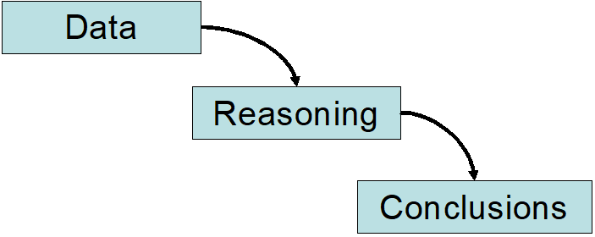
Summit Economics, LLC specializes in empirical research and rigorous analysis to provide objective and quantifiable support for sound decision making. The firm provides research and consulting services in applied socio-economics, public policy, market research, economic impact analysis, real estate research, urban economics, and strategy development. Our most frequent engagements support decision-making, quantify visioning and planning, develop performance metrics, or assist with risk management.
For more information, please visit www.SummitEconomics.com, or email paul@summiteconomics.com

Slide 3
Analysis & Documentation Purpose
This analysis and documentation seeks to reasonably forecast the real estate and fiscal impacts of the Nevada/Tejon URA project on Colorado Springs and URA developer interests if the current pass through of 1.5% of taxable sales to the URA and three private developers is increased to 2.0%.

Slide 4
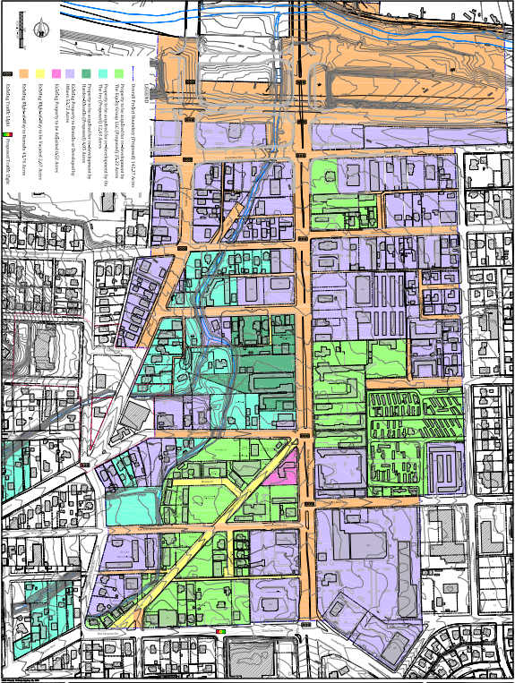
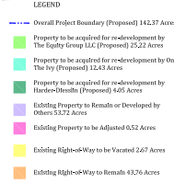
The S. Nevada Avenue/Tejon Street Urban Renewal Area (Nevada/Tejon URA) was formed in 2015 to stimulate redevelopment of the blighted S. Nevada and Tejon corridors south of I-25 and adjacent to the Ivywild and Stratton Meadows neighborhoods. In total the Nevada/Tejon URA is comprised of 142.4 acres. Unlike most urban renewal areas which have a single private developer receiving local sale tax increments resulting from redevelopment, the Nevada/Tejon URA is siloed with multiple private developers. The green and blue shaded areas on the map are controlled by three development groups and the fourth silo (purple area) is comprised of other properties that are in the area owned by many separate owners whose decisions to redevelop are totally reliant on market conditions.
Notes:
Add constraints, leverage, vulnerabilities, and problems
Research Routt Recreation Roundtable

Slide 5
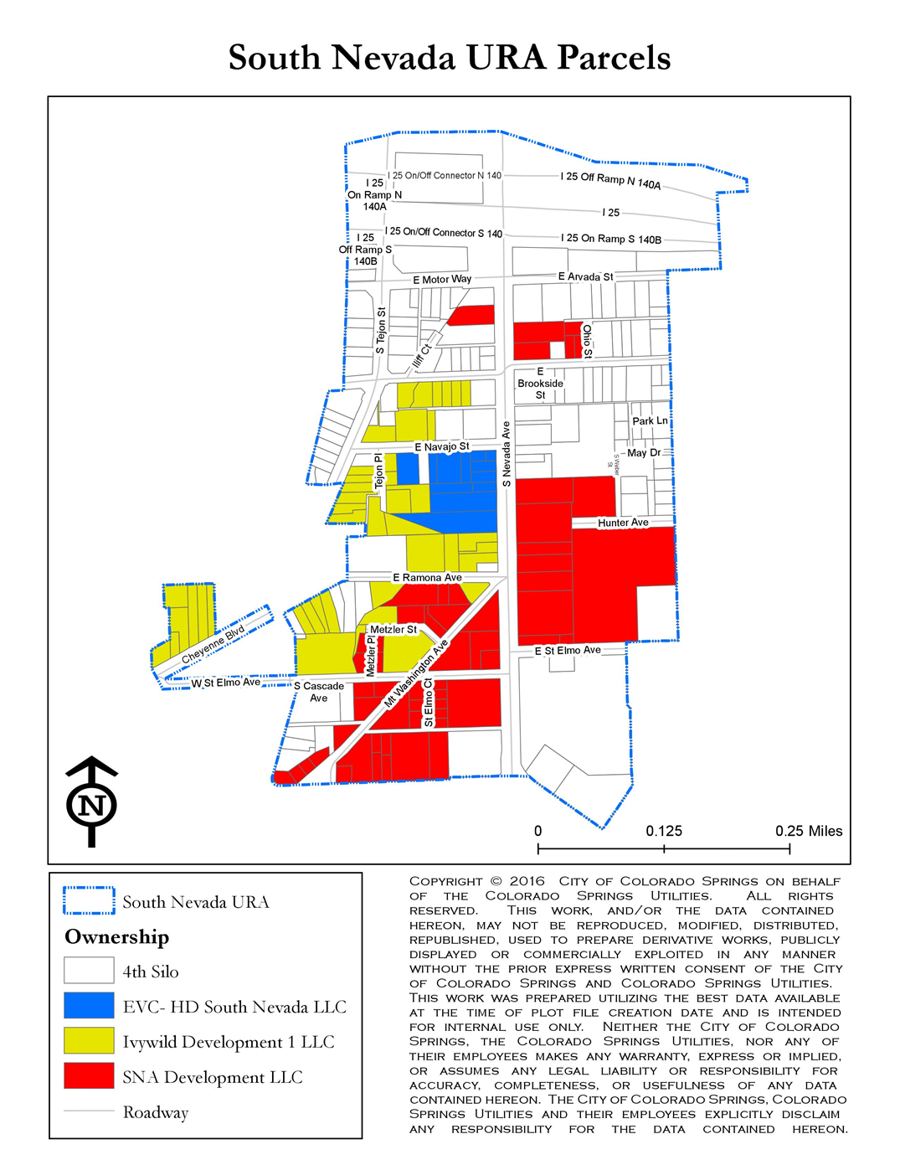
Four Silos – The Original Intent
Silo 1 - Development / Redevelopment Potential (SNA Development, Inc./ The Equity Group)
Many of the parcels in Silo 1 are adjacent to the S. Nevada Avenue right-of-way, which is a major arterial roadway in the area. Potential redevelopment in Silo 1 includes retail shopping centers, pad retail shops and restaurants, office space, lodging and residential units.
​​Silo 2, Canyon Creek - Development / Redevelopment Potential (Ivywild Core Development, Inc.)
The redevelopment plan for parcels in Canyon Creek include both residential and commercial projects. Planned residential development includes 45 townhomes and 90 apartments. Planned commercial development includes a hotel (159 rooms), retail restaurant 4,000 s.f. and 7,000 s.f. up-scale restaurant) and office space (2,500 s.f.)
Silo 3 - Development / Redevelopment Potential (EVC-HD Nevada South LLC)
Silo 3 is the smallest of the four Silos in the URA. A Natural Grocers store of approximately 15,000 square feet was opened in 2017. In-line retail space with approximately 10,000 s.f. was completed in 2017.
Silo 4 - Development / Redevelopment Potential Silo 4 contains 357,000 square feet of existing building area. Currently, development in Silo 4 is split among two broad land use categories; residential (49%) and commercial (44%). Potential redevelopment in Silo 4 includes in-line or pad retail shops and restaurants, office space and redevelopment of an existing neighborhood shopping center.

Slide 6
Development Agreements
  The three different development agreements are very similar. The key difference between silos is the commitment to apply 4th Silo’s revenue to SNA Development for completion of Off-site Public Improvements (aka excess costs).

Slide 7
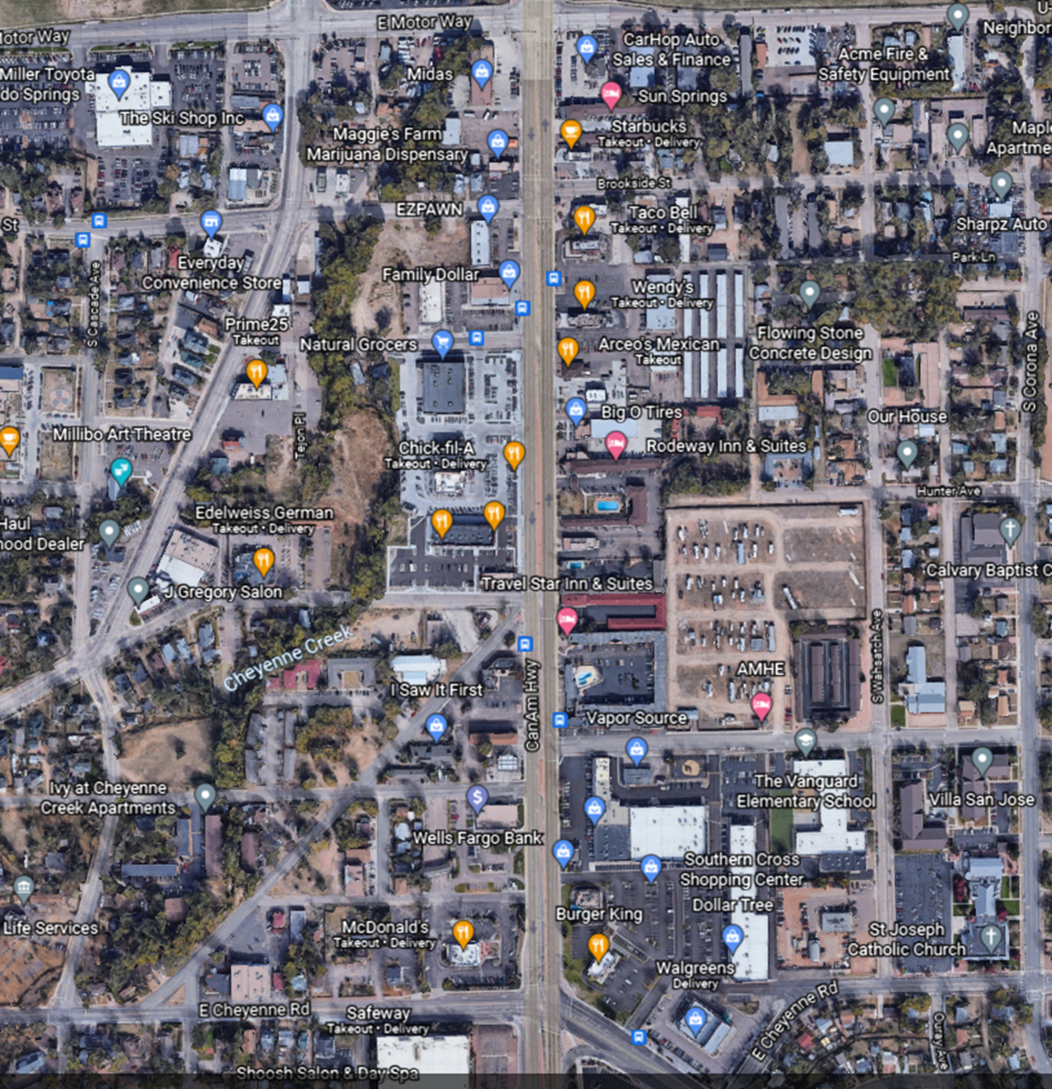
Current Status
​In the past three years, numerous new businesses along Nevada’s west side have been developed. The Shoppes on South Nevada southwest of Nevada Avenue and Navajo Street are home to Natural Grocers, Chick-fil-A, Five Guys Burgers and Fries, and Zoes Kitchen. A multi-tenant building northwest of Nevada and Ramona Avenue houses Smashburger, Tokyo’s Joe’s an AT&T store, and European Wax Center. The Canyon Creek Townhome project has completed 19 townhomes and is a second phase of 24-units is under construction. Three additional 25-unit apartment buildings may start construction in 2021 - 2022 along Navajo, Brookside Street and Mount Washington Avenue. Grading and sitework for a 159 room hotel has commenced southeast of the Prime 25 steakhouse. Creekwalk, a 52,000-square-foot, five building shopping center northwest of Nevada and Cheyenne Road, is 54% leased and scheduled for completion in 2021 along with Cheyenne Creek reclamation to the west of the development.
Small segments of Cheyenne Creek are being upgraded by adjacent private redevelopment, but there appears to be no plan for a continuous creek greenway trail.

Slide 8
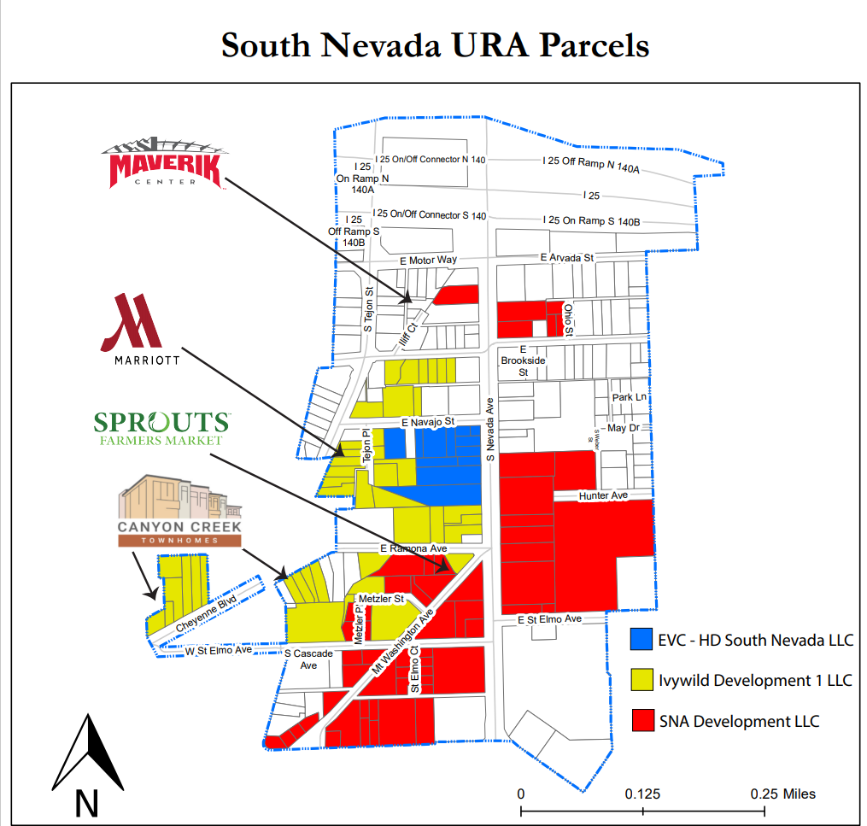
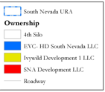
Development Opportunities Remaining by Silo
EVC – HD: Complete
Ivywild Development: Complete on S. Nevada, remaining lots are primarily residential. New 159 room hotel across from Ivywild School and 7,500 sf of retail on S Tejon. With rezoning east of Cheyenne Blvd and Tejon, new commercial possible over time combined with higher density residential, especially with extended creek scaping and pocket greenways? Future anticipated projects include: 50 apartments Navajo & Brookside, 35 apartment units (Mount Washington Dr, 24 townhomes S. Cascade).
SNA/Equity Group: Strong potential remaining as a result of Creekwalk followed by 34,500 sf. Creekwalk North including a 23,175 Sprouts (w/ a signed lease) and extensive relationships with other property owners to continue redevelopment.
4th Silo TBD: Fragmented redevelopment should be stirred by other redevelopment occurring. Sales tax TIF pledged to the Equity Group, so to the degree privately funded public improvements are needed specific to the area, that could be a challenge relative to specific properties.

Slide 9
URA & Developer Public/Private Partnership Accounts to Date
An estimated $7.2 million have been invested in public infrastructure by the developers. The level of sales tax URA pass throughs to developers to date totals $846,000.
SNA/Equity Group only recouped $136,000 on the $4 million invested in public improvements ($22 million including the BID). No TIF was received (through 2020) from the 4th Silo.

Slide 10
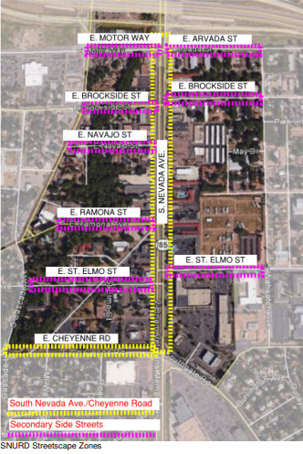
Public Improvements to Date
Streetscape standards were developed for much of S. Nevada located in the Nevada/Tejon URA. These improvements were made in 2017 and are intended to enhance the area’s aesthetics and functionality adjacent to portions of all four development silos. There is no coordinated approach to maintenance with only SNA and a few property owners cooperating in a BID to maintain and complete some finishes on the improvements
Transportation Improvements: The City of Colorado Springs initiated several transportation improvements projects in the South Nevada Urban Renewal and Ivywild areas beginning in June 2019. This project rebuilt the center median on Nevada Avenue between Navajo Street and Ramona Avenue to create left-turn lanes to Navajo Street and the shopping center on the west side of Nevada Avenue. When complete, this segment of Nevada Avenue will include a traffic signal mid-block between Navajo Street and Ramona Avenue.

Slide 11
Completed Public Improvements by Developers
Completion of Cheyenne Creek reclamation and pocket greenway along creek. (SNA/Equity Group)
E. Cheyenne Rd between South Nevada and Cascade Avenue widening (SNA/Equity Group)
New traffic signal at Roanoke and Cheyenne Rd. (SNA/Equity Group)
Electrical transmission undergrounding on westside of S. Nevada (SNA/Equity Group)
Cheyenne Road streetscape and traffic signal Upgrades at Cascade Avenue & Cheyenne Road (SNA/Equity Group)
Creek reclamation and pocket greenway along Cheyenne Creek (Ivy)
Stormwater infrastructure improvements (All)

Slide 12
Planned Public Improvements – Creekwalk North
Stormwater upgrades within new development
Extension of Cheyenne Creek reclamation & greenspace
Streetscape along South Nevada Avenue
Traffic Signal Upgrades – Ramona Avenue & St. Elmo Avenue @ Nevada Avenue

Slide 13
Conclusions that drive modeling
SNURA is probably the most challenging URA in the history of Colorado Springs due to the pre-existing levels and longevity of blight in the area.
Urban renewal tends to works better when there a single entity driving redevelopment efforts. Globally it’s often the public sector or a master developer with extensive public sector support.
In the SNURA, the effort is fragmented except to the extent that SNA/The Equity Group has the greatest financial incentive and therefore commitment which has been demonstrated to date.

Slide 14
The fundamental threat & opportunity
Maintain the momentum.
The SNURA has successfully stimulated momentum. Without market momentum redevelopment efforts slow and can stop. Given successful urban renewal is a story that typically unfolds over decades, sustaining momentum when it occurs is critical.
The impact model offers two scenarios:
The current scenario which is assumed to finish out projects currently underway and then halt, and a prospective scenario assuming the momentum substantially continues into the future as developer incentives are enhanced by a greater promise of recouping public investment.

Slide 15
Fiscal impacts considered – Sales & Use Tax Only
Incremental sales tax from retail sales paid to stores in the URA from the 0.5% proposed increase and continuation of additional commercial development.
Incremental sales tax paid by new residents in the URA on purchases they make outside the URA.
Use tax paid by private developers on materials used in residential and commercial construction.
Spillovers resulting from very modest increases in residential property values outside the URA, but within ½ mile of the URA boundaries.

Slide 16
Other key assumptions
Inflation rate 2.7%/ year (reverting back to the mean from early 1980s to 2005)
Increments shown start in 2022
BID improvements included in overall construction cost or are public improvements that do not result in use taxes
Sales taxes paid by residents outside the URA do not sunset – remaining at 3.2%
Taxable expenditures outside the URA bur inside the City are 20% to 22.5% of income which is a function of occupancy cost which is related to Assessor market values.
Spillovers are created by more opportunities in the URA for surrounding neighborhoods which increases residential values, incomes, and taxable expenditures.

Slide 17
Baseline Scenario – If no changes are made and momentum halts in coming few years**
Baseline scenario shows increase in taxable sales from the projects listed in the adjacent table. No new projects after those currently anticipated for completion by 2023.
** Baseline scenario is incremental above the TIF realized through 2021

Slide 18
Maintaining Momentum Scenario – Incremental Commercial Sales Tax Generated
Same projects developed as Baseline PLUS
By moving sales tax pass thru to 2% and creating incentive to continue developing commercial property with taxable sales, an additional $20.9 million can be generated through 2040 to reimburse private investment in public improvements.

Slide 19
Use Tax on Construction Materials
Incremental construction
It appears the use taxes projected to result as momentum is maintained will accrue only to the City, including its special funds. At a 3.2% total sales tax rate, the materials can generate $3.6 million through 2040.

Slide 20
Sales tax paid on purchases outside the URA by new and higher income residents in the URA
Purchases made outside the URA by new residents in the URA moving into new apartments, townhomes and other residential development plus incremental purchases by slightly higher income residents in the URA netted against the loss of some residents resulting from demolition of residences (agglomeration effect) are shown to generate $4.0 million in additional sales tax to the City and its special funds.
Square feet of URA residential included

Slide 21
Spillovers from adjacent neighborhoods as a result of the dramatic reduction of blight in the URA
Beginning state in adjacent neighborhoods
Additional purchases are made by slightly higher income households who are occupying slightly higher valued homes. The greatest impact is likely to come from the Ivywild neighborhood. Stratton Meadows will take much longer and experience more modest gains. The total impact is shown to be $1.4 million in additional sales tax receipts to the City and its special funds through 2040

Slide 22
Total Modeling Results – Community Fiscal Benefits
To the degree tax pass-thru under a TIF pay for public improvements, Colorado Springs receives additional infrastructure and additional sales tax receipts.
The total additional sales and use increment available to reimburse developers for public improvements is forecasted at $20.9 million and the additional increment to the City is $9.0 million by increasing the sales tax rate to 2% and thereby maintaining redevelopment momentum in the URA.

Slide 23
Sources
Colorado Springs Business Journal
URA Website
Interviews with Danny Mientka
El Paso County Assessor data including census based demographic data
Other research conducted by Summit Economics on proximate values
Secondary sources

